Slide 1
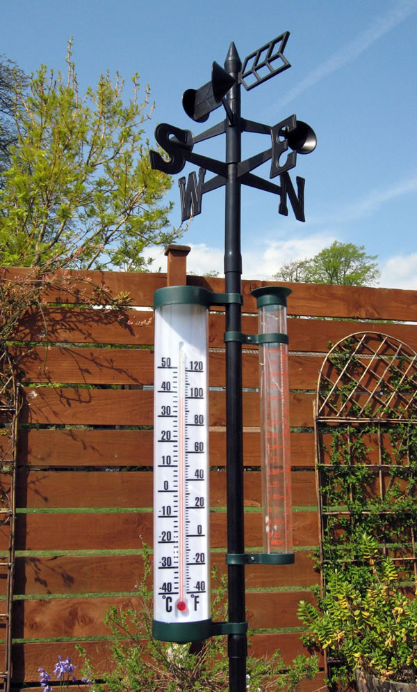
The Weather of Pacific Northwest Gardens
Cliff Mass
University of Washington
March 2019

Slide 2
The weather influencing Puget Sound and western interior gardens
Temperature: mild year round. Rarely below 25F or above 90F. Allows a wide range of plant species in our gardens.
Precipitation: moderate annual rainfall in the lowlands (35-45 in) . Big annual variations---wet winter, but dry summer.
Substantial local variations of both temperature and precipitation

Slide 3
Why mild?

Slide 4
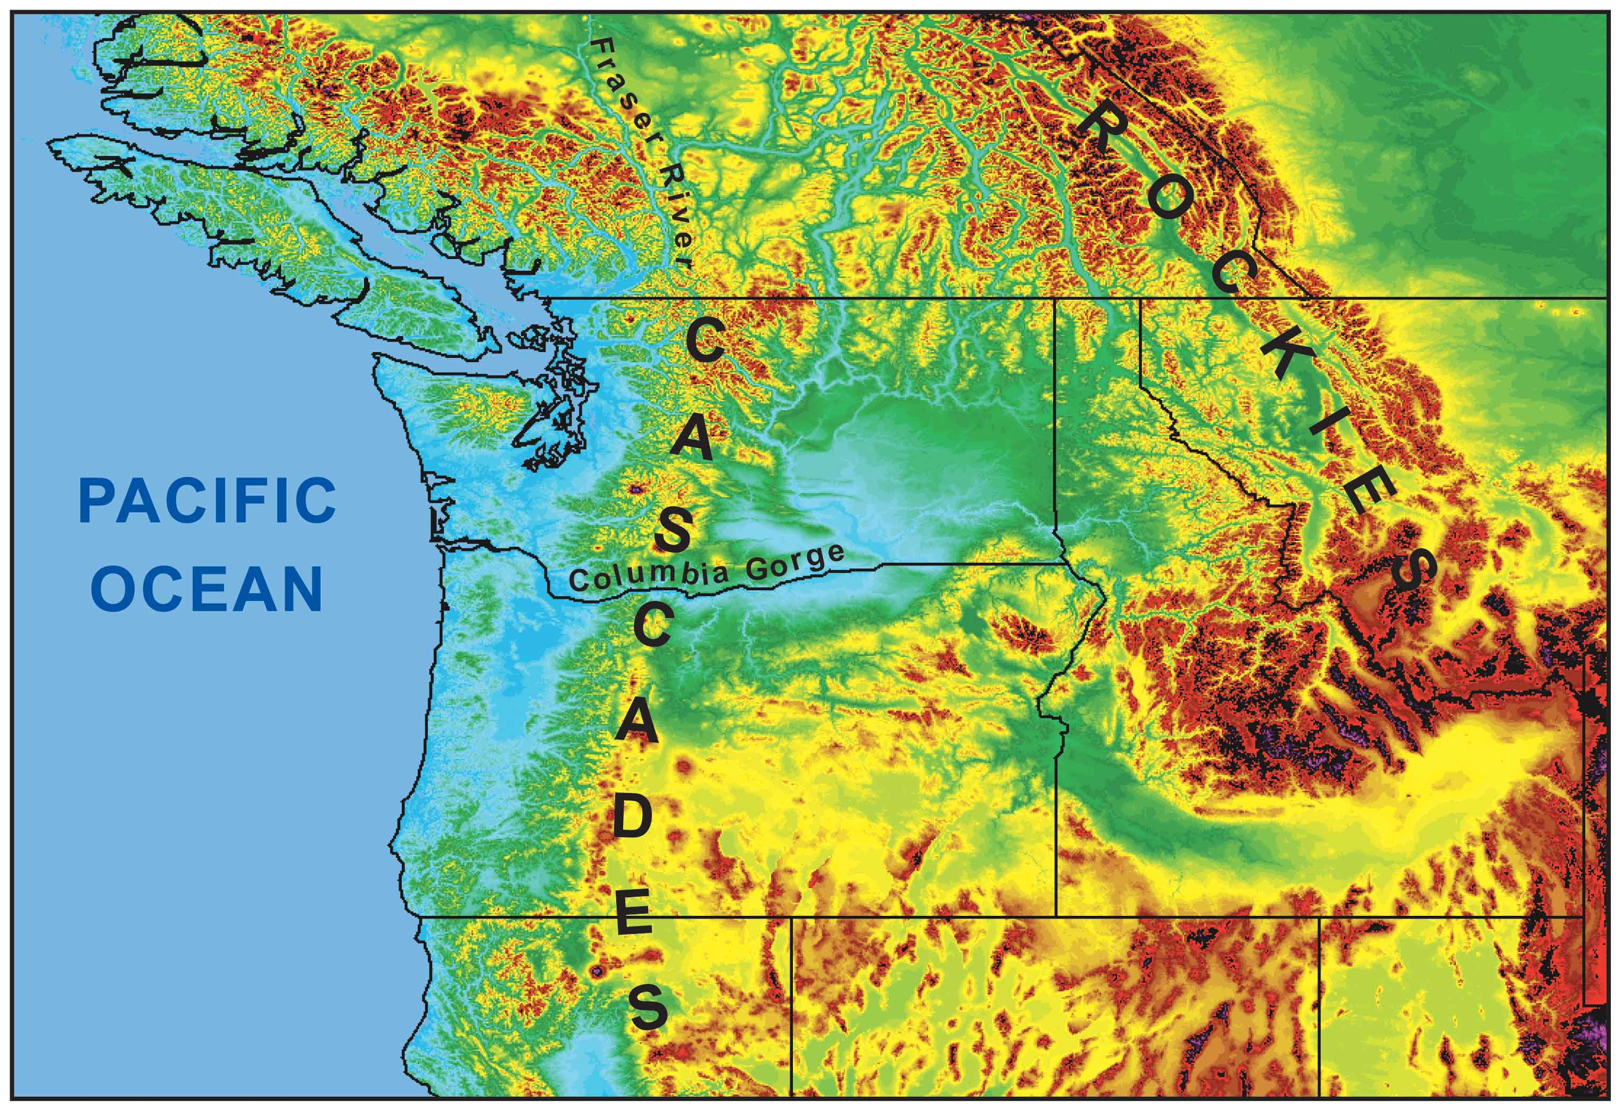
During the winter the mountains block the cold air from the interior.
Cold
Air

Slide 5
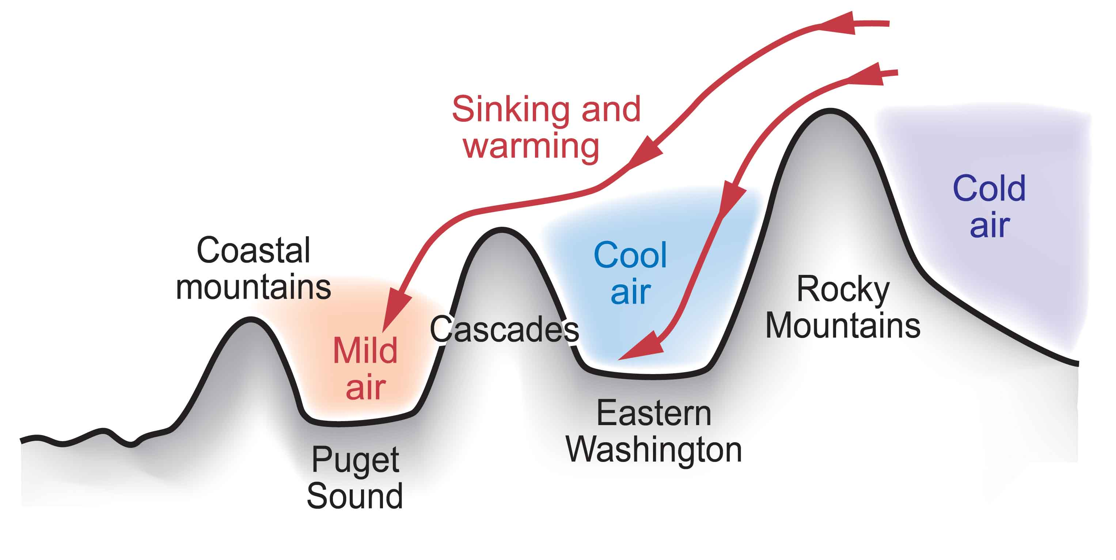
Cold Air from the Continental Interior Has a Hard Time Reaching Western Washington

Slide 6
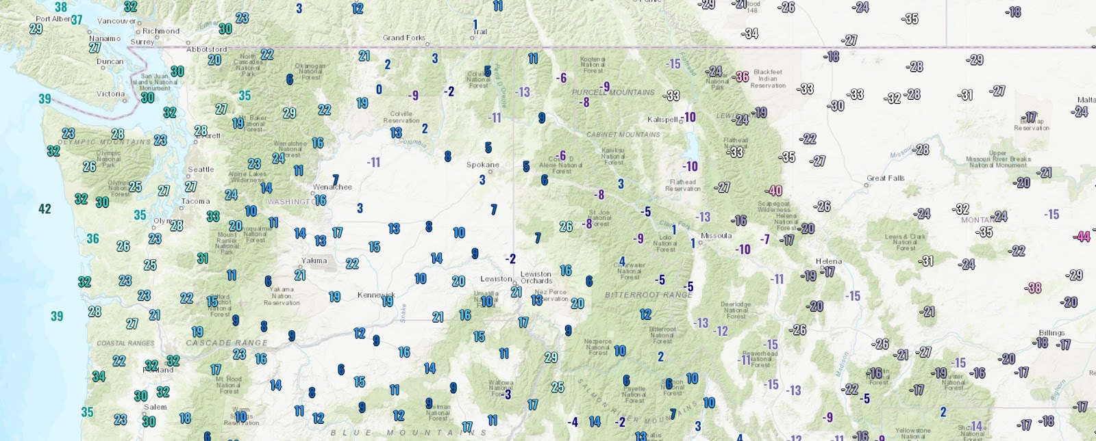
This Last Sunday Was a Perfect Example

Slide 7
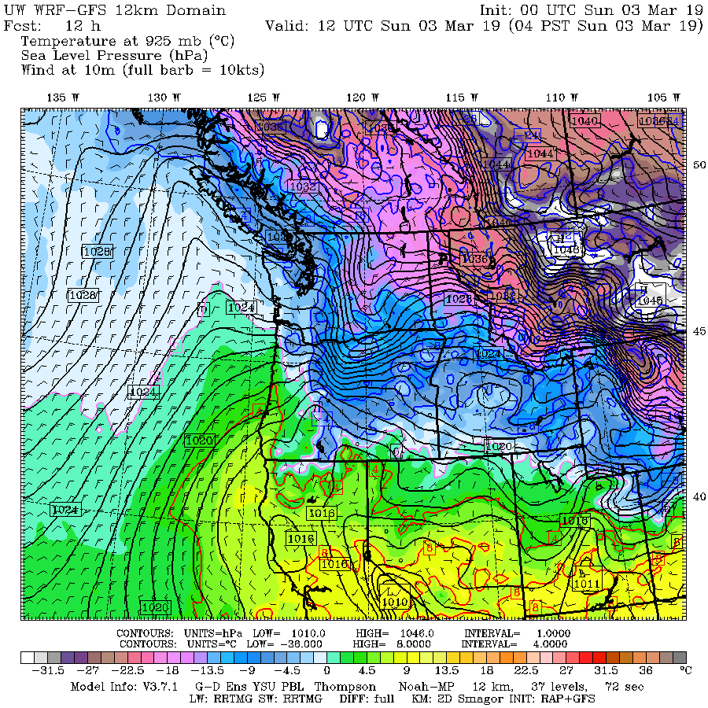

Slide 8
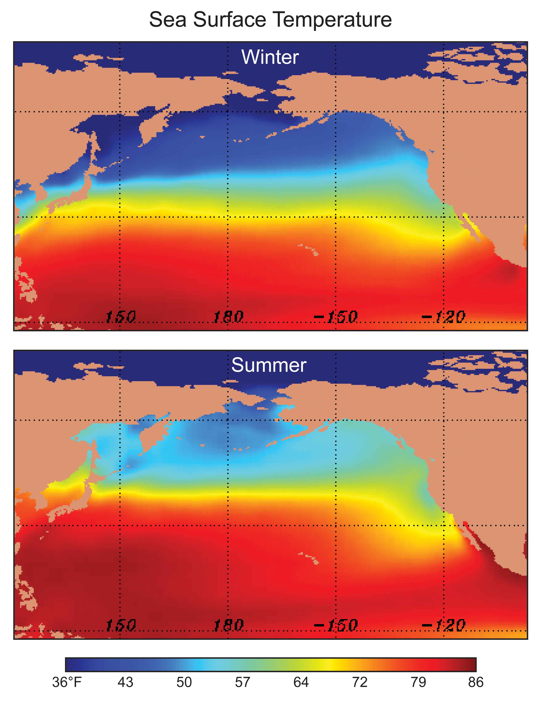
Our air and weather systems generally
move west
to east:
Thus, our
weather comes from off
the mild
Pacific

Slide 9
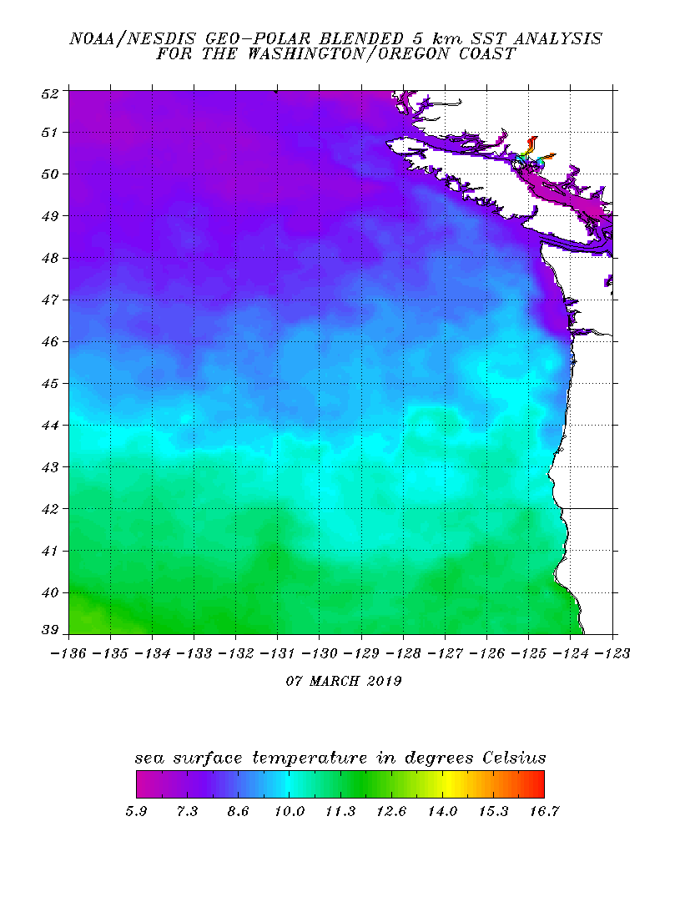
And the Pacific is relatively mild, even in mid-winter
10C is 50F

Slide 10
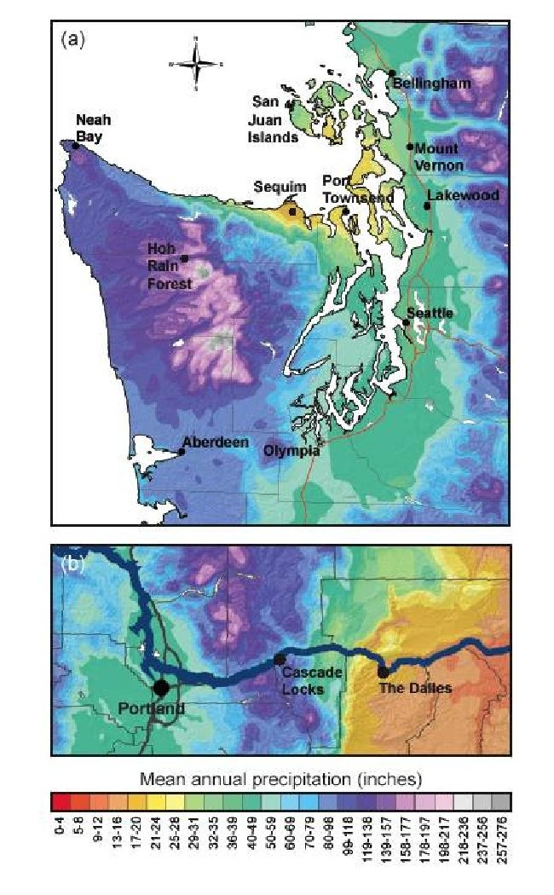
Precipitation Contrasts

Slide 11
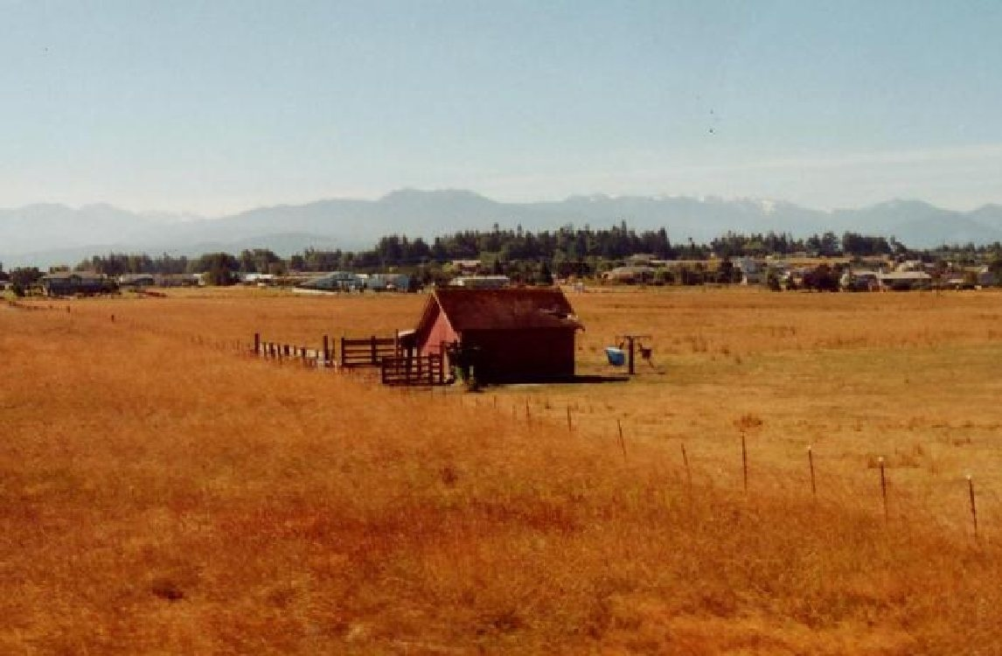
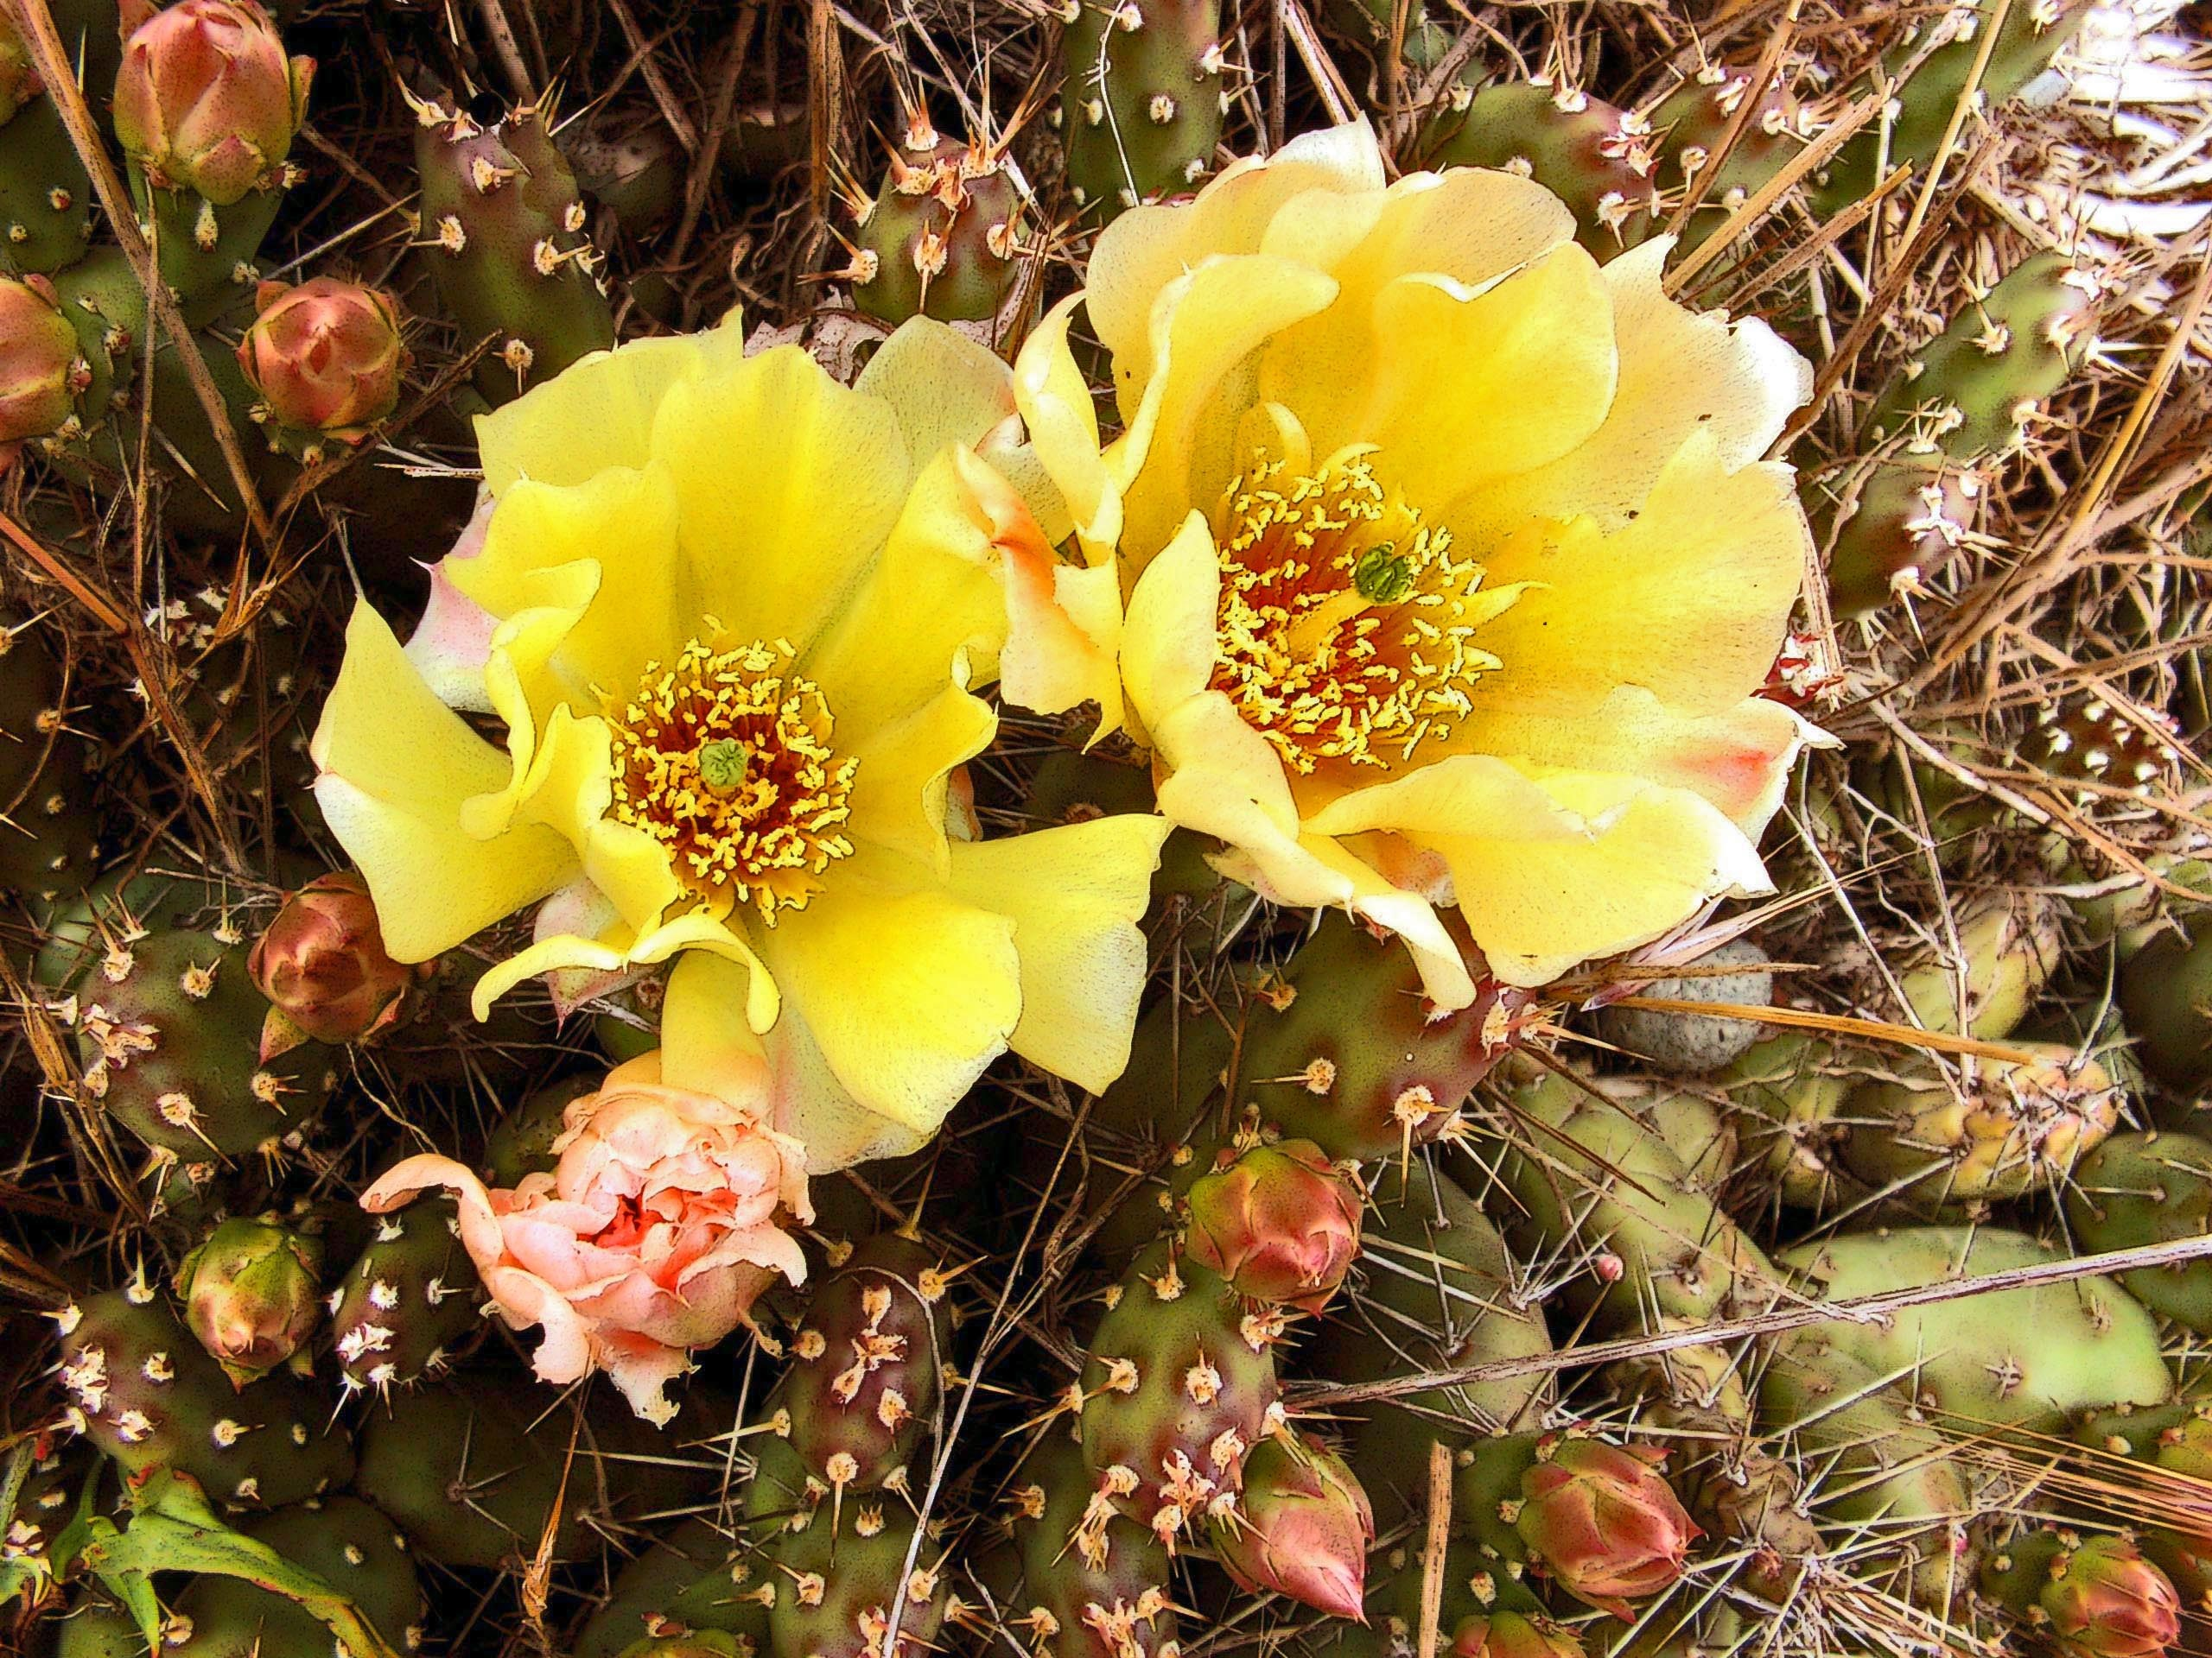
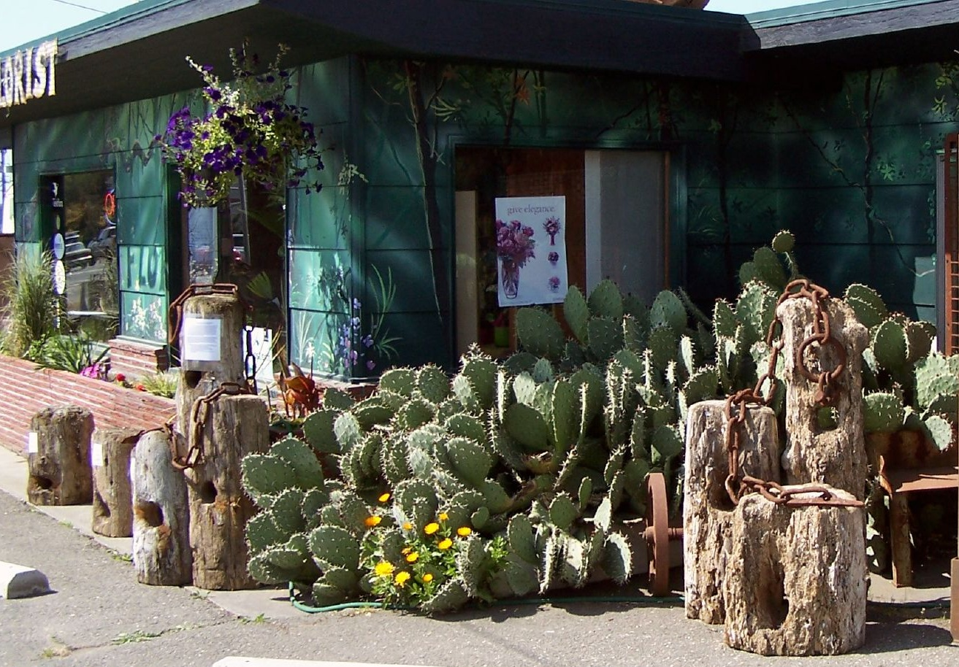
Sequim: Haven for Retirees

Slide 12
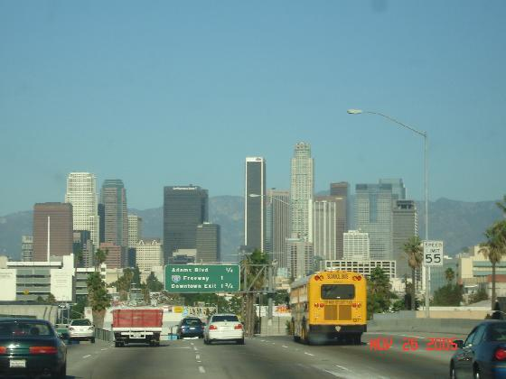
Annual Precipitation
Sequim: 15.97 inches
Los Angeles: 14.89 inches

Slide 13
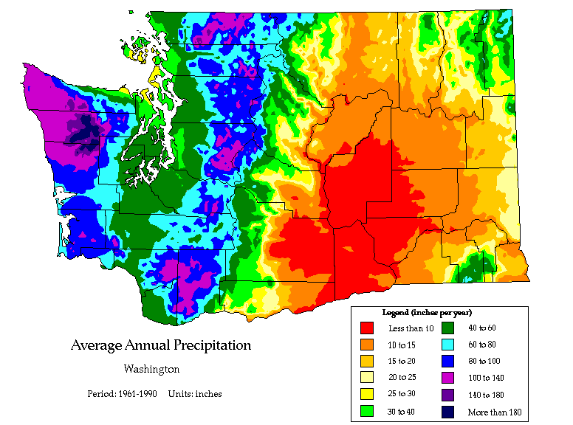

Slide 14
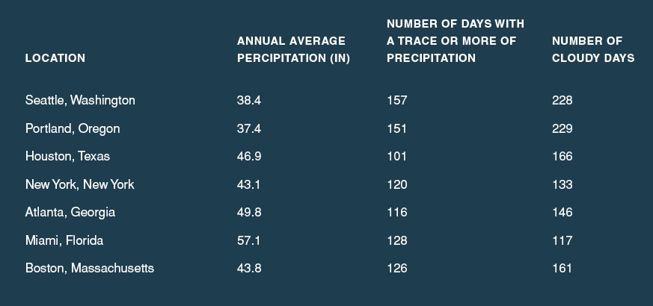
The Puget Sound area really isn’t that wet—partially because we are often in the rainshadow of the Olympics

Slide 15
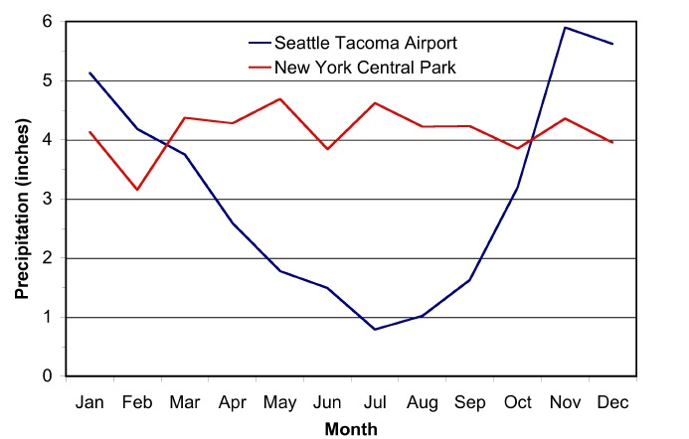
The Northwest Has a Mediterranean Climate
Moss Season
Growing Season
Moss Season

Slide 16
Why are our summers so dry?

Slide 17
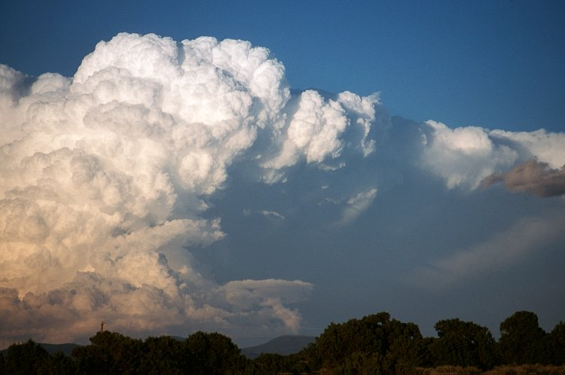
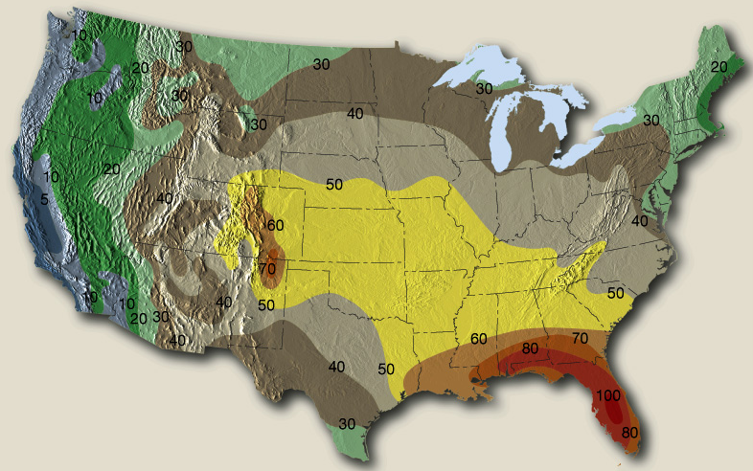
The Northwest Gets Fewer Thunderstorms Than Almost Anywhere in the U.S.

Slide 18
Very Strange Situation With Sport’s Facilities

Slide 19
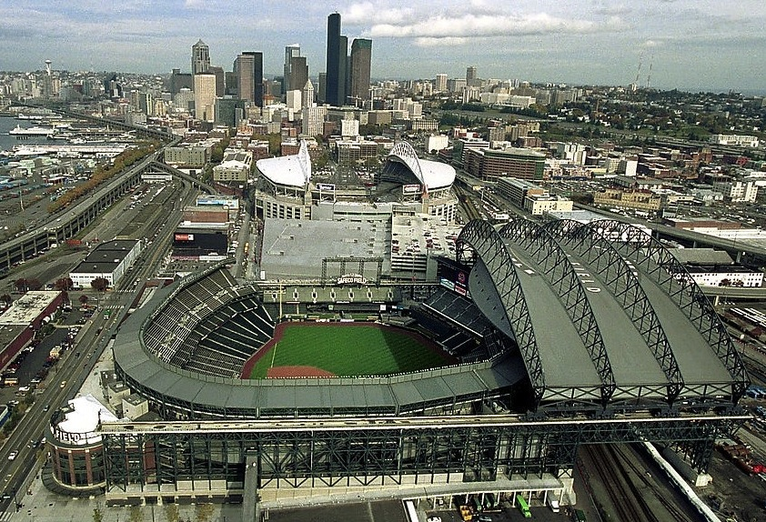
Safeco Field: 100 million dollar roof

Slide 20
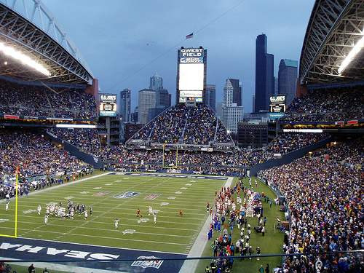
CenturyLink Field: No Roof

Slide 21
Storms of the Pacific Northwest

Slide 22
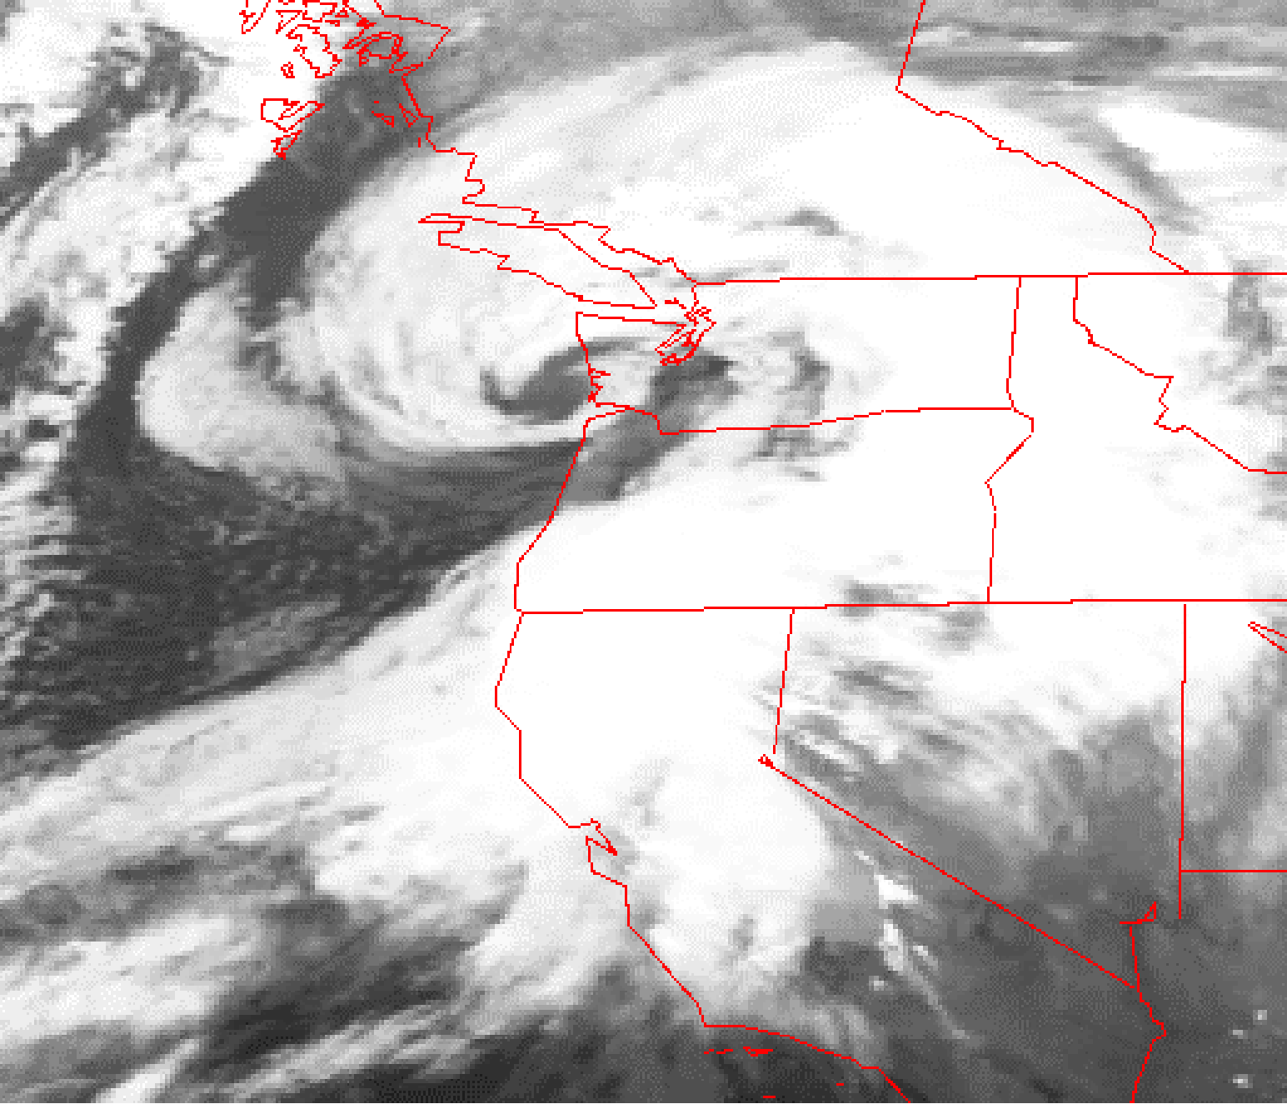
Our powerful windstorms are generally associated with strong low pressure systems, called midlatitude
cyclones
Inauguration Day Storm January 20, 1993

Slide 23
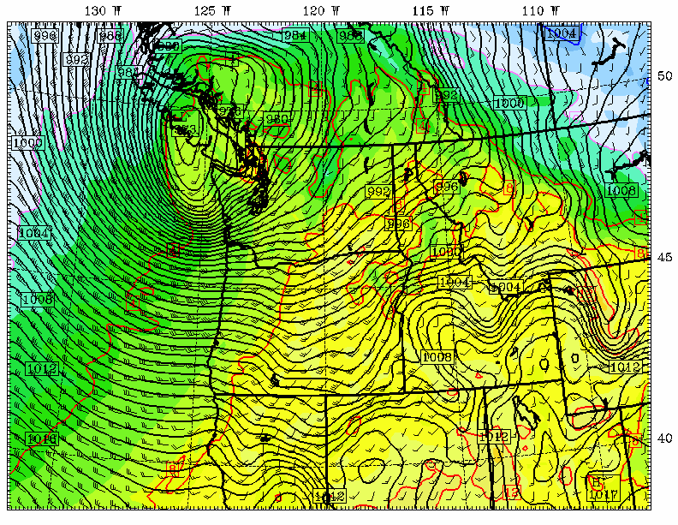
Chanukah Eve Storm: 18-h forecast for 10 PM December 14, 2006
L

Slide 24
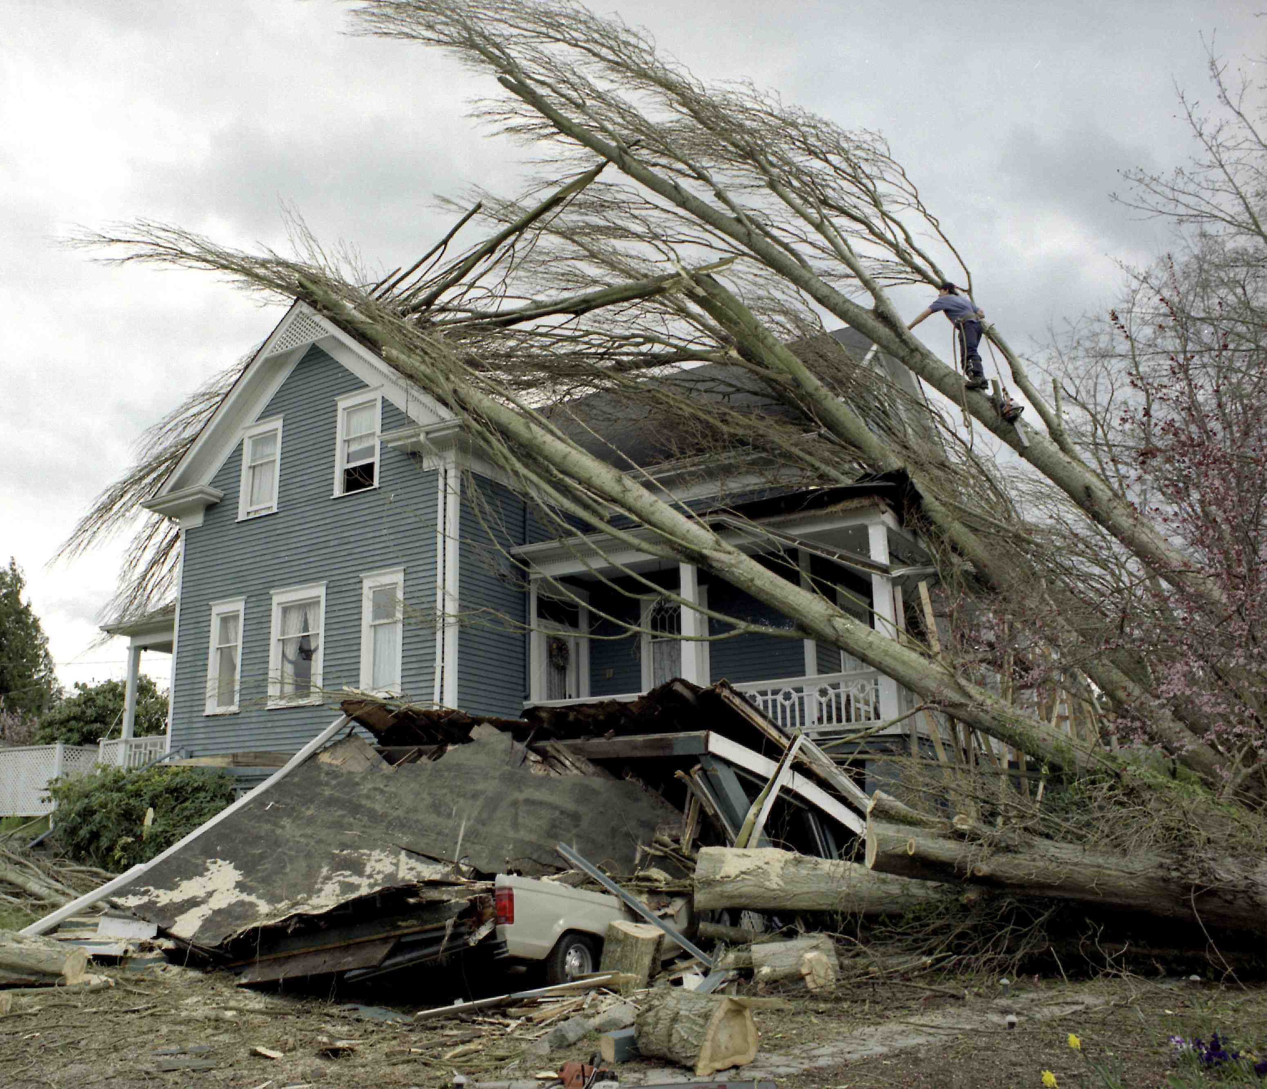
Trees—storm force multiplier

Slide 25
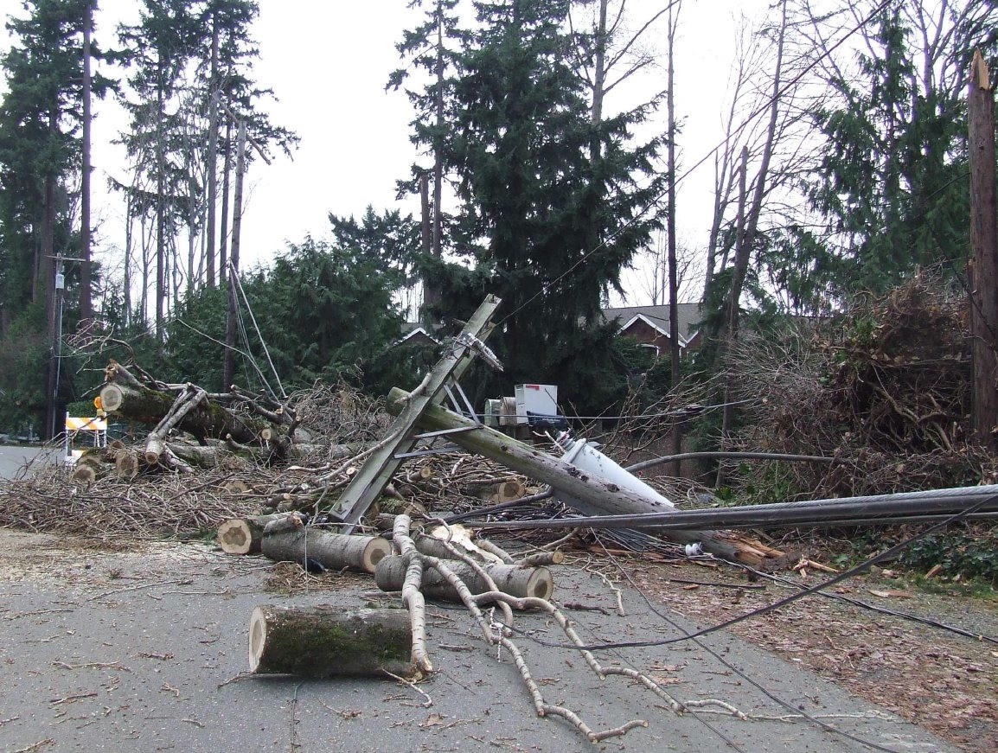
Mercer Island, December 15, 2006

Slide 26
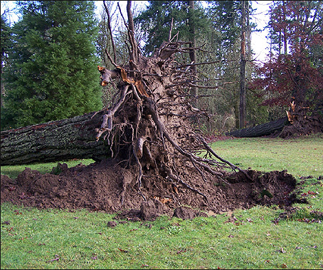
The damage was extraordinary— made far worse by the heavy precipitation of the previous month.
Photo Courtesy of Wolf Read

Slide 27
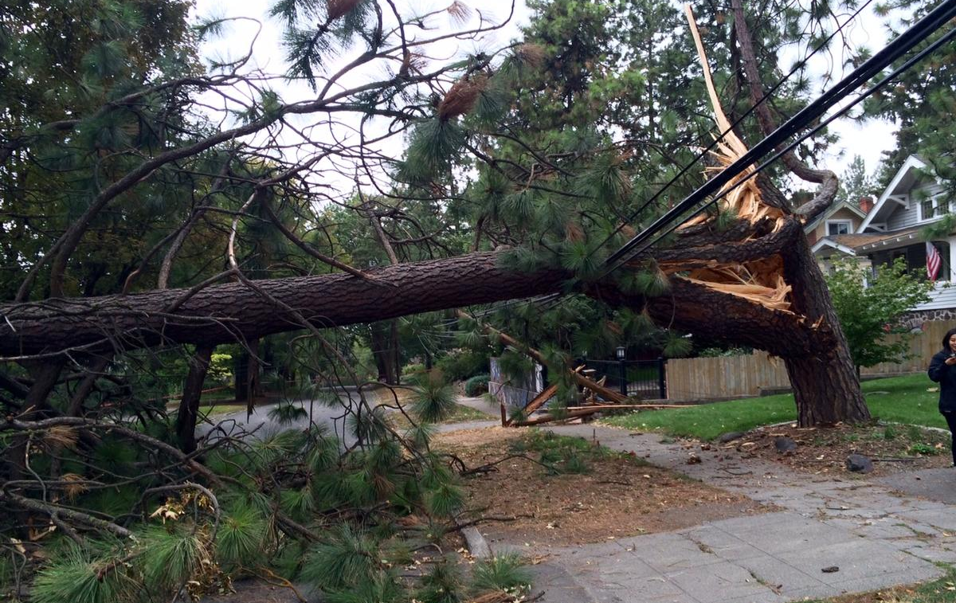
Windstorm Damage to Trees
Significant damage generally starts with gusts to 40 mph
More damage early in the season, with untested branches and leaves
Wet soil contributes to failure of tree roots.

Slide 28
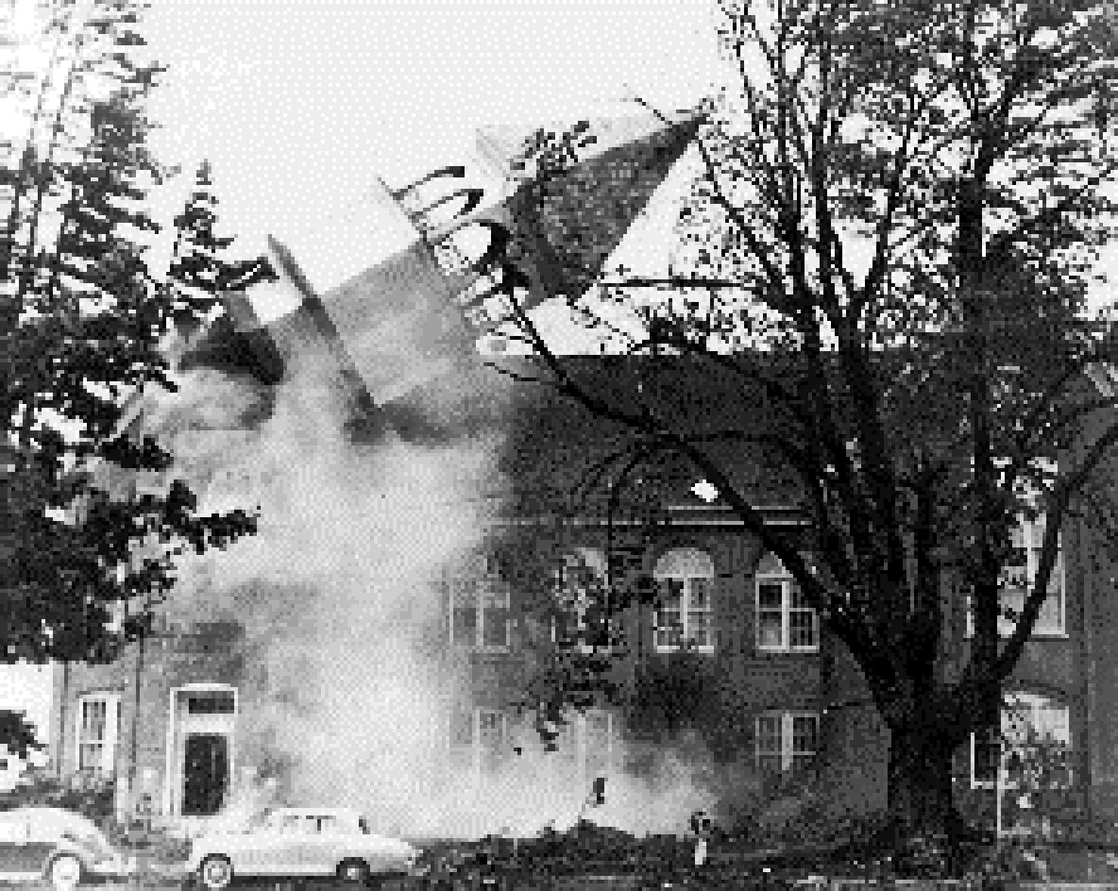
The Most Extreme Northwest Windstorm: The Columbus Day Windstorm of 12 October 1962

Slide 29
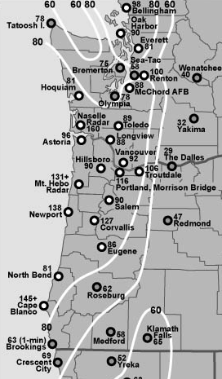
Max Winds (mph)
Columbus Day Storm 1962
Graphic courtesy of Wolf Read

Slide 30
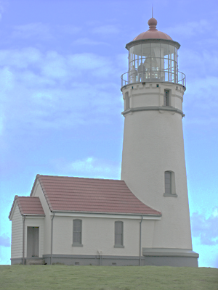
Columbus Day 1962: At Cape Blanco there were 150 mph with gusts to 179!
Cape Blanco,
Photo courtesy of
Bureau of Land
Management

Slide 31
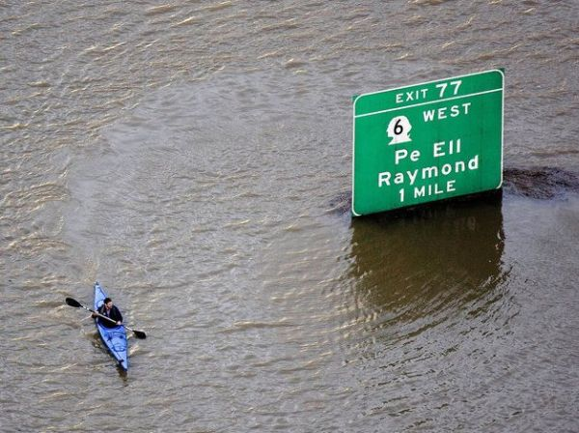
The most costly extreme weather of the Northwest is
Flooding

Slide 32
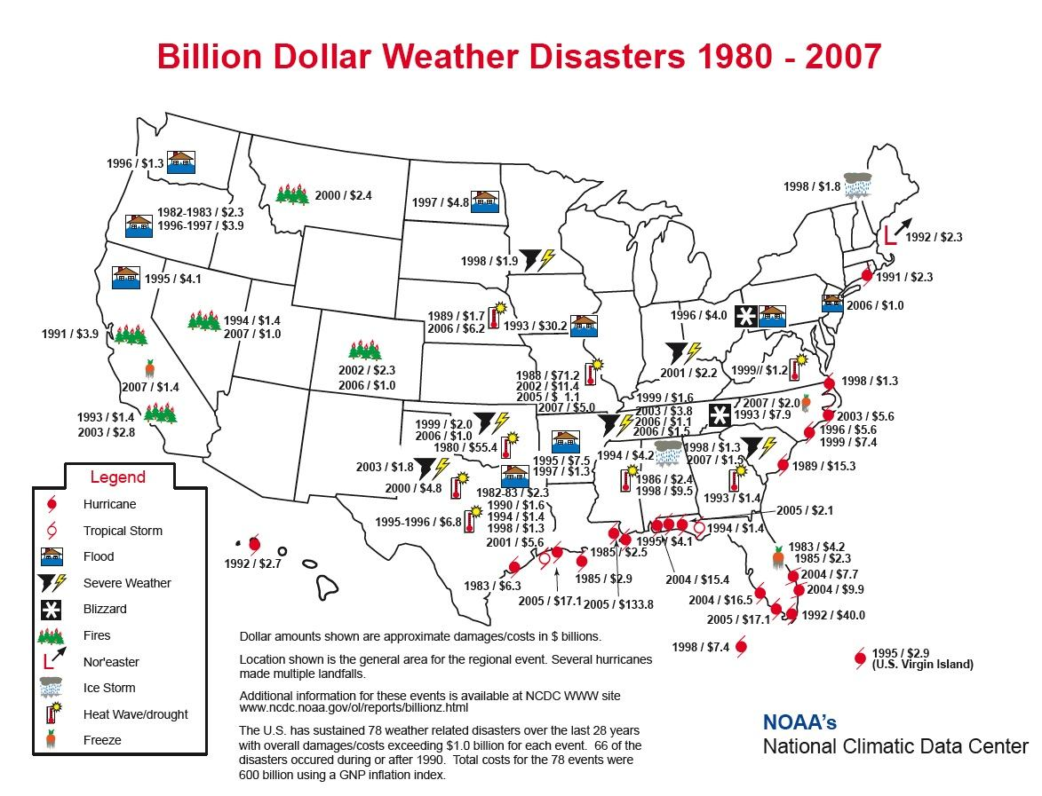

Slide 33
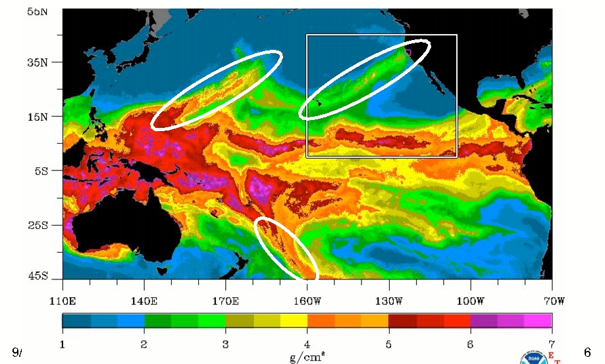
Most are associated with atmospheric rivers, a.k.a. the “Pineapple Express”
A relatively narrow current of warm, moist air from the subtropics…often starting near or just north of Hawaii.
atmospheric rivers

Slide 34
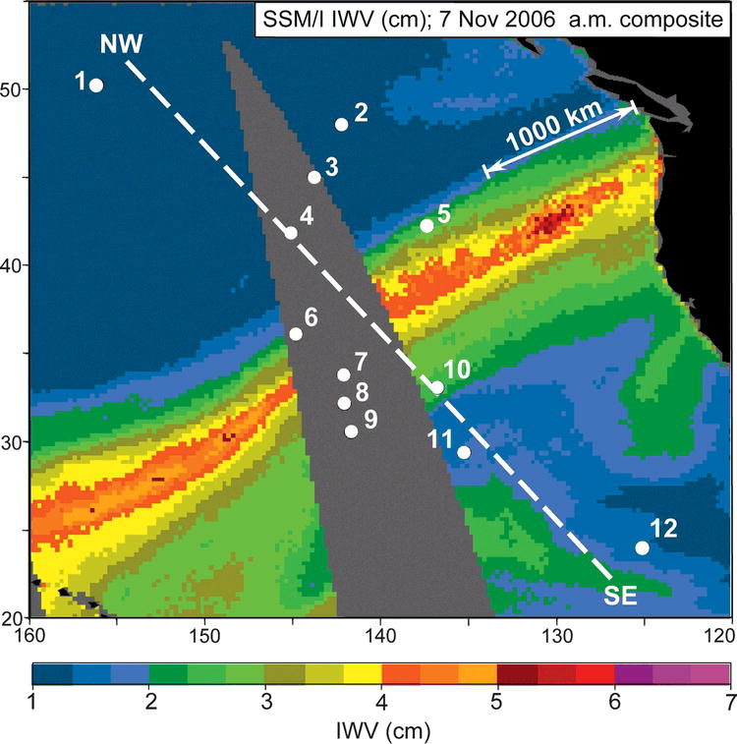
A Devastating Pineapple Express Occurred on
November 6-7, 2006

Slide 35
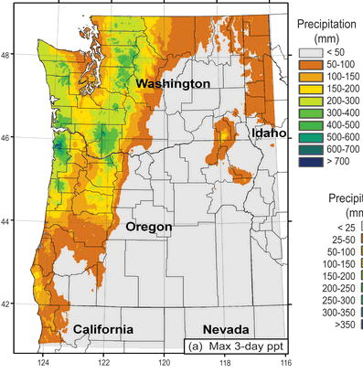
November 6-9,
2006
Dark Green: about 20 inches

Slide 36
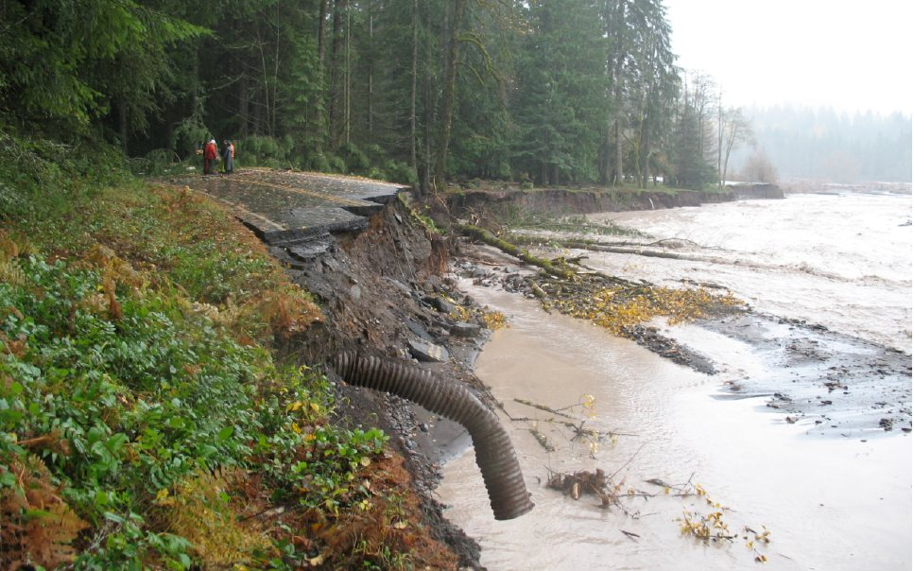
Mount Rainier National Park
18 inches in 36 hr (Nov 8, 2006)

Slide 37
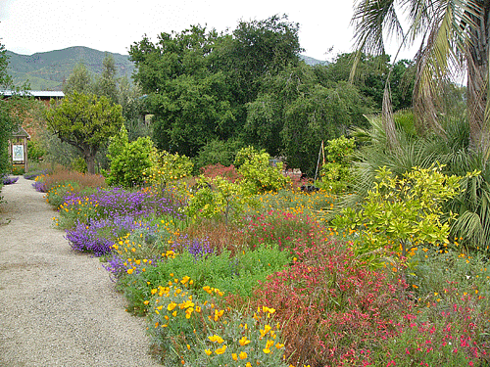
Microclimates 101

Slide 38
Microclimate: the climate of a small area

Slide 39
Microclimates are controlled by…
  elevation,
  topography,
  proximity to water,
  vegetation type,
  soil type,
  soil moisture,
  nearby buildings,
  slopes in relation to the sun,
  how reflective the surface is,
  … and more

Slide 40
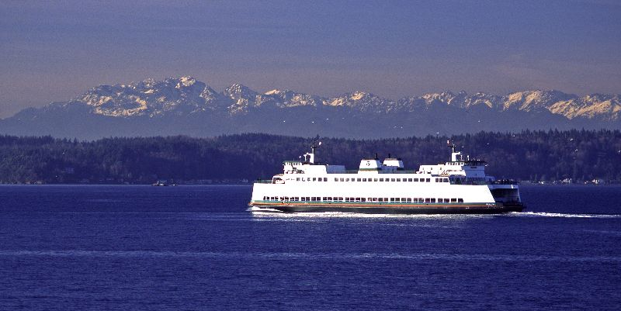
Microclimate 101
Areas near water tend to be warm during the winter and cool in summer compared to inland areas.

Slide 41
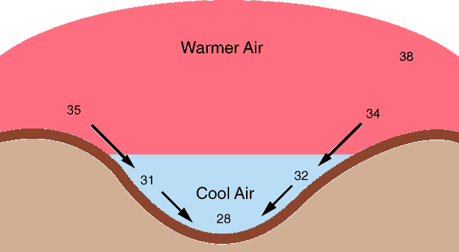
Temperatures are generally cooler in low spots on cold, cloud-free nights.

Slide 42
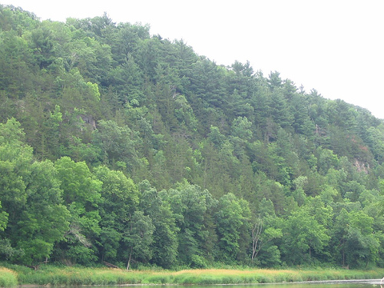
The Bottom of Vegetated Slopes Are Often Much Cooler During Summer Days-as evaporation from plants causes cooling

Slide 43
Temperatures at the level of your face can be very different than just above or at the ground

Slide 44
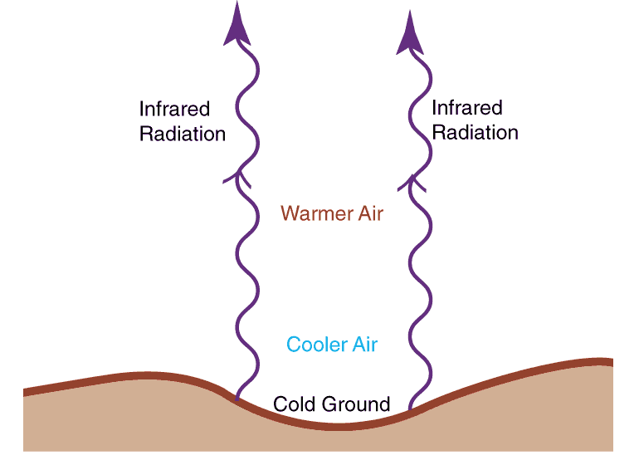
Air can be much colder near the ground on clear nights

Slide 45
Cold, Clear Nights
Temperatures can be 1-5F less at the ground than at 5-6 feet!
Areas under trees or carports cool off more slowly. Why?
Some of the infrared radiation is absorbed and reradiated back to the surface

Slide 46
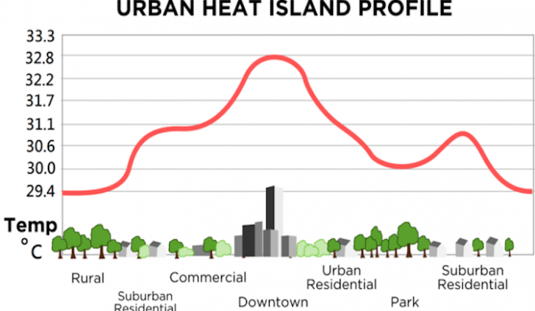
Urban Heat Island Effect

Slide 47
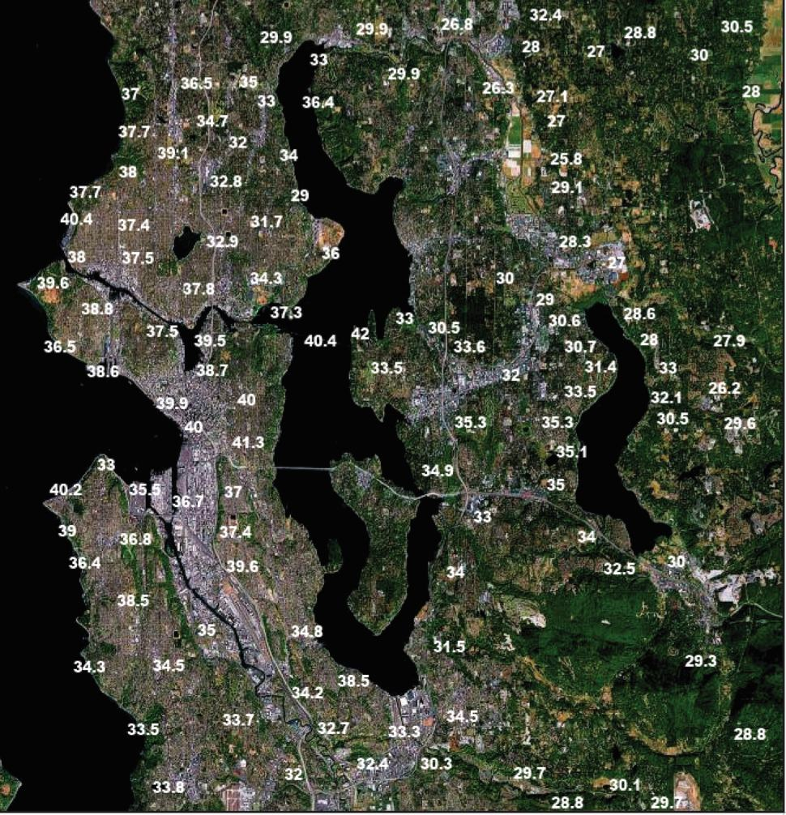
Cold, Clear Winter Night

Slide 48
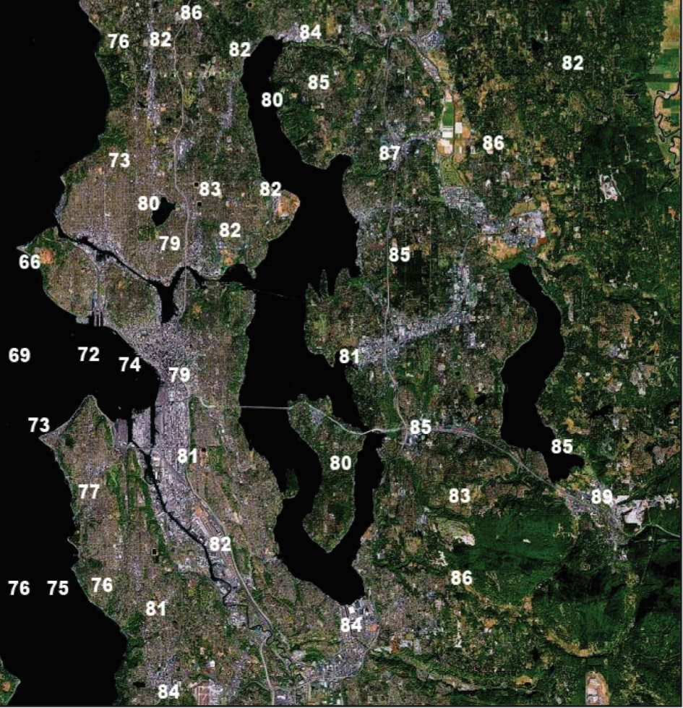
Warm, Summer Day: The opposite

Slide 49

South-facing slopes are usually much warmer than north-facing slopes
North
South
Less direct rays,
thus cooler
South facing
slope

Slide 50
Warm microclimate on south sides of buildings
South
Solar Radiation
Infrared
radiation

Slide 51
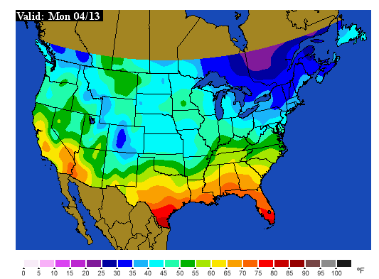
Soil Temperatures: The Inside Story

Slide 52
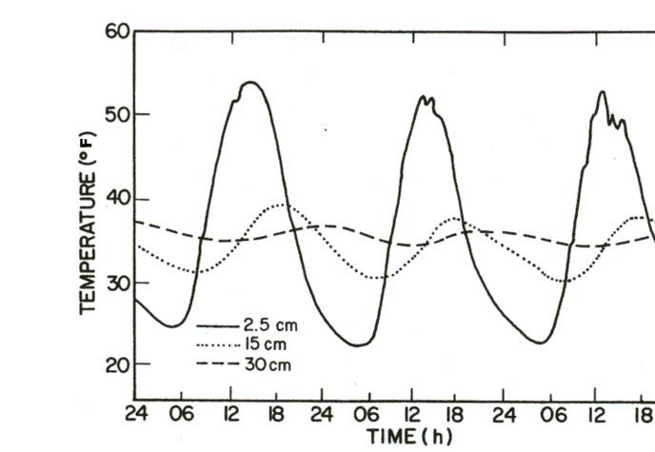
Soil Temperature Changes with Depth
Inch deep (solid), 6 inches deep (dotted), 1 ft deep (dashed)

Slide 53
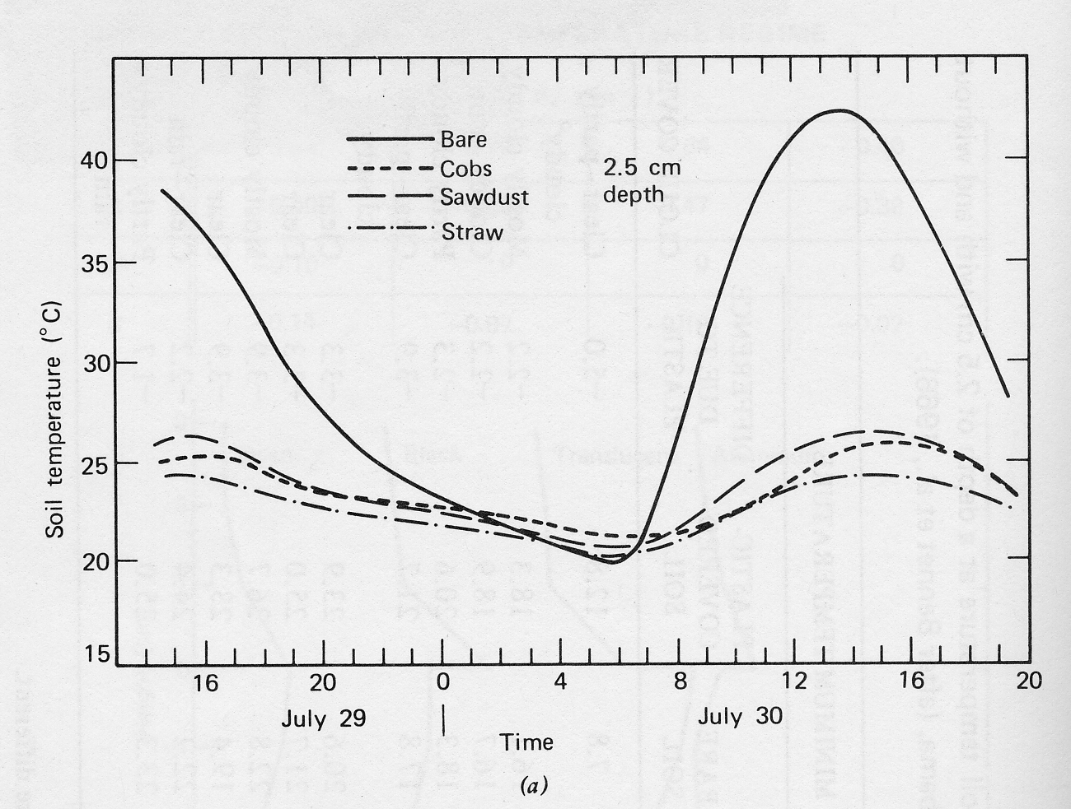
The influence of mulches: summer

Slide 54
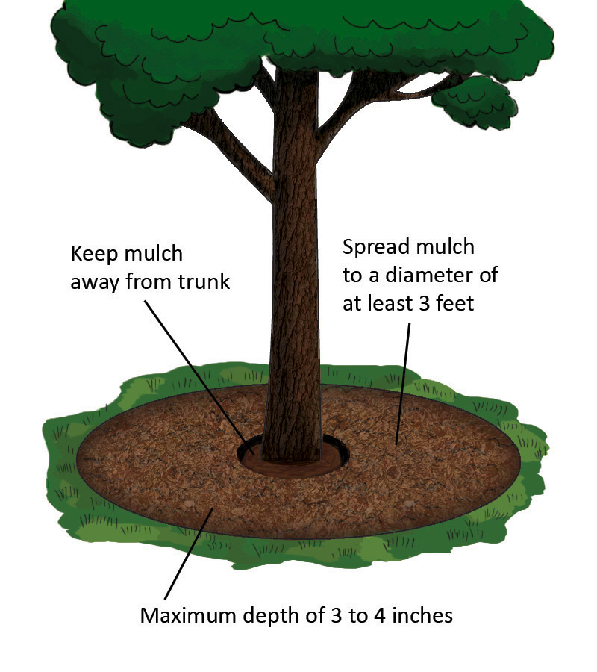
Mulches can protect during winter

Slide 55
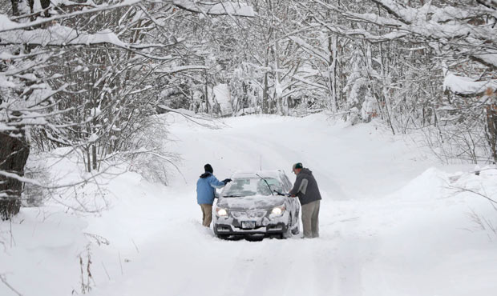
Mulches
So several inches of mulch can really help to protect sensitive plants from a cold wave.
Just as good as mulch…a several-inch snowfall!

Slide 56
Germination Temperatures
If the soil is too cold, germination can be delayed or fail.
My vegetable seeds planted during some Aprils never germinated for that reason.
Need to check the soil temps.
Minimum temps for:
  Cucumber, pepper, eggplant 60F
  Carrot, beet, parsley 40F
  Bean, tomato, corn 50F

Slide 57
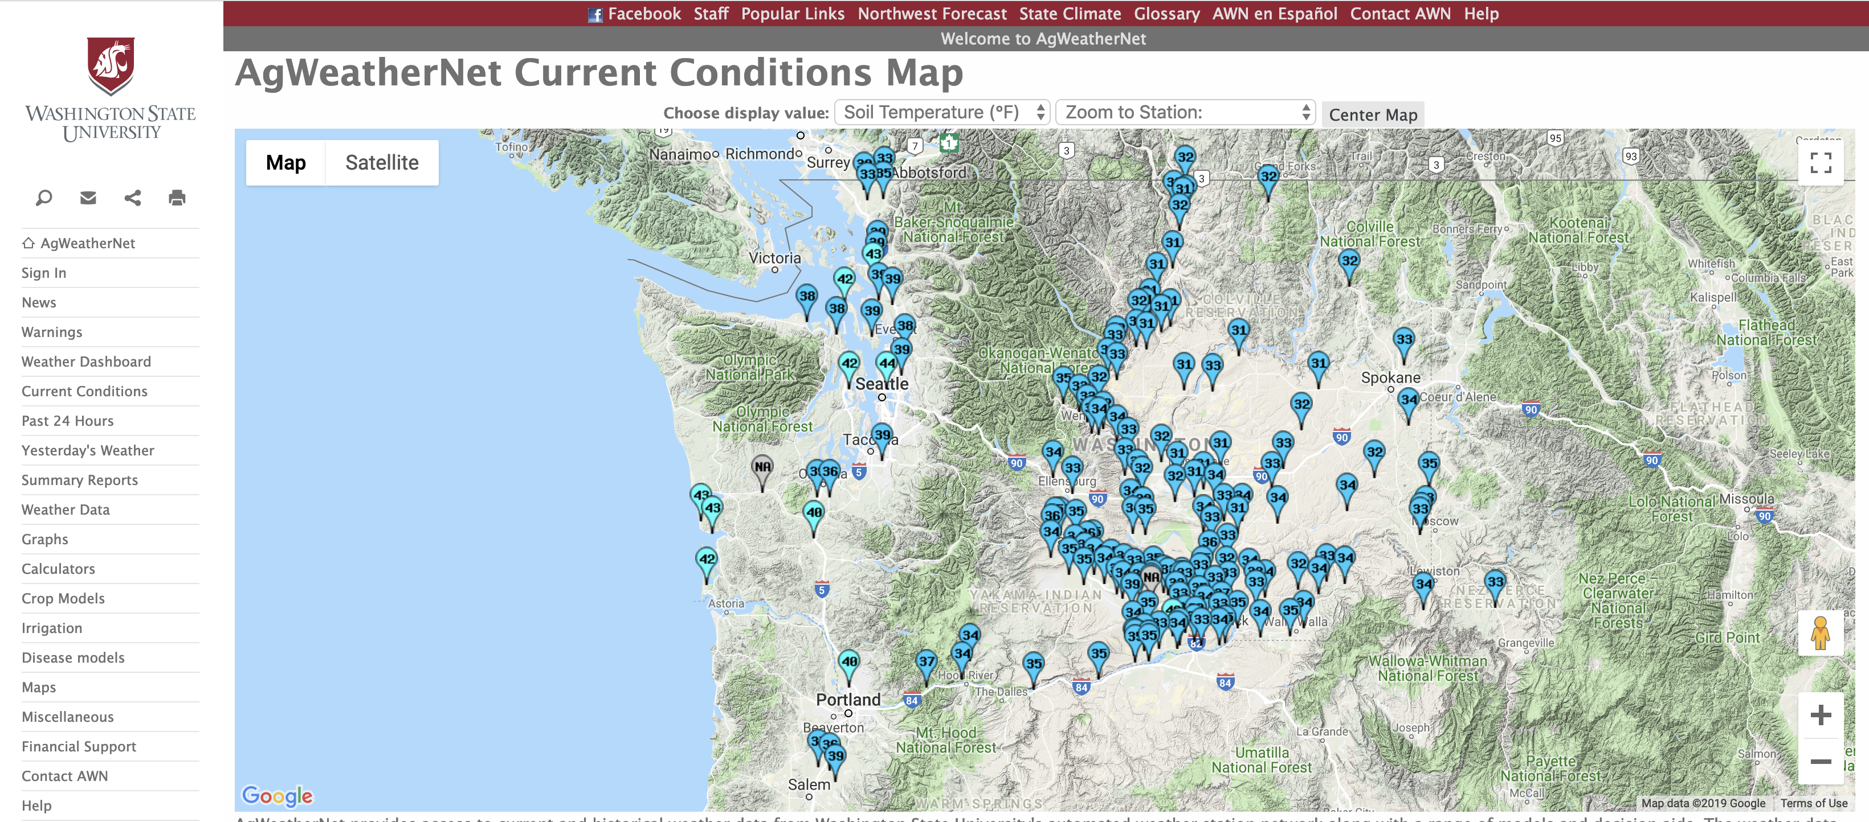
Good Place to Get Soil Temperatures
https://weather.wsu.edu/

Slide 58
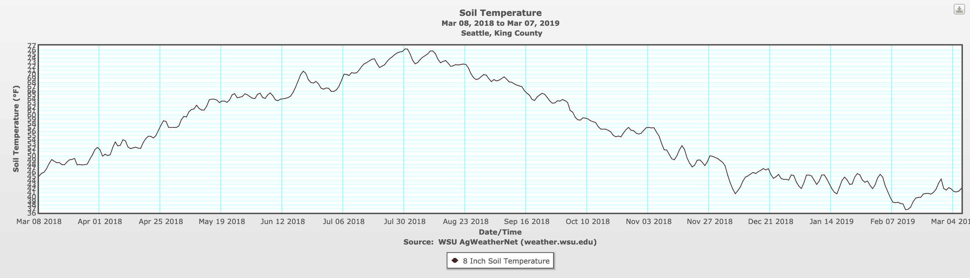

Slide 59
The Northwest has a wide collection of local weather features

Slide 60
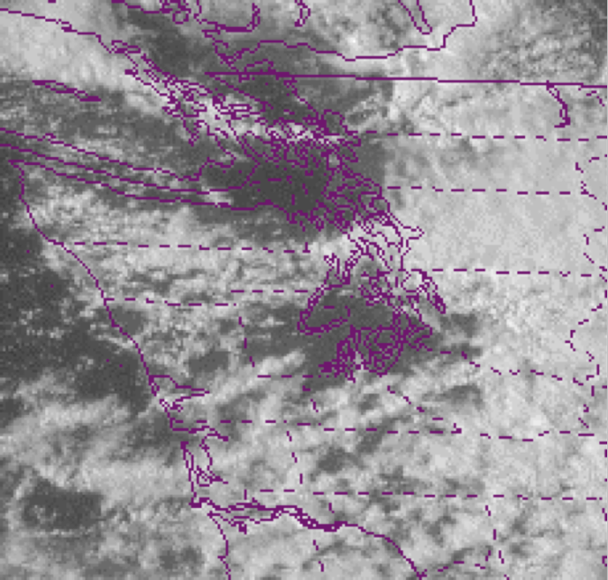
Puget Sound Convergence Zone

Slide 61


Slide 62
The Source of Plant-Killing Cold: The Fraser River Gap

Slide 63


Slide 64


Slide 65

December 29, 1990

Slide 66

Two major cold waves in Dec 1990

Slide 67

Hardiness Zone Maps
Are VERY Approximate

Slide 68

Is this useful for a gardener?

Slide 69
Absolutely useless
Nick Bond of NOAA in Seattle evaluated the Almanac’s forecasts over several years
Found absolutely no skill. Better off flipping a coin.
Want more proof?

Slide 70


Slide 71
The End

Slide 72
Gaps in our regional mountain barriers have a huge impact on local weather

Slide 73
Notes:
73
Use this slide to introduce where the Gorge is and the nature of the gap flow scenario.
Spend some time pointing out important features like:
The mountain barrier, the Columbia Basin and how it provides a topographically confined air shed and note how the Gorge is the only drain
Then switch gears and point out other gaps on this map (Frasier, JDF, Stampede, Chehalis) and mention important results of each
Frasier - cold outflow, Juan de Fuca - easterly gales, westerly gales, PSCZ, Chehalis - PSCZ, Stampede - downslope windstorms, CRG - Cold outflow, gales, wintry precipitation
So meteorological phenomena driven by gaps are obviously very important, especially in the PNW.

Slide 74

Enumclaw, Washington
“Place of evil spirits”

Slide 75


Enumclaw and nearby foothills locations can experience severe windstorms…while calm winds occur a dozen miles away
Winds over 118 mph
December 24, 1983

Slide 76

December 24, 1983

Slide 77

Why Enumclaw?

Slide 78

During the warm season, the same gap produces strong winds near Ellensburg, making possible the wind farms of the area.
Wild Horse Wind Farm

Slide 79


Slide 80
Some of our local weather features are more benign--but no less interesting

Slide 81

Lenticular or Mountain Wave Clouds
Picture courtesy of Art Rangno

Slide 82

Picture Courtesy of Darlisa May Black

Slide 83

Mountain Wave Clouds

Slide 84

Wave Clouds

Slide 85

On June 24, 1947, Kenneth Arnold, flying a small plane between Chehalis and Yakima, spotted a group of “saucer-like” objects over Washington State

Slide 86
Thus was born the UFO craze that continues until this day

Slide 87

Thus was born the UFO craze that continues until this day

Slide 88

During a recent presidential debate on October 30, 2007, candidate Dennis Kucinich admitted that he saw a UFO while staying at Shirley McClain’s home.

Slide 89
What did both of these sightings have in common?

Slide 90

Both occurred over Washington State near Mount Rainier

